Slide 1
Set it Forever
Join Process breakdown

Slide 2
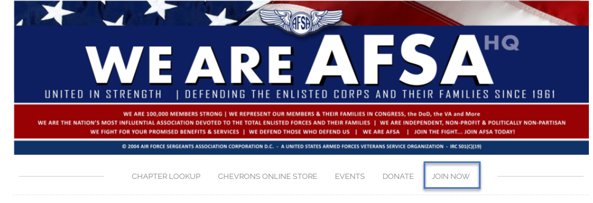
Click on the Join Now Tab

Slide 3
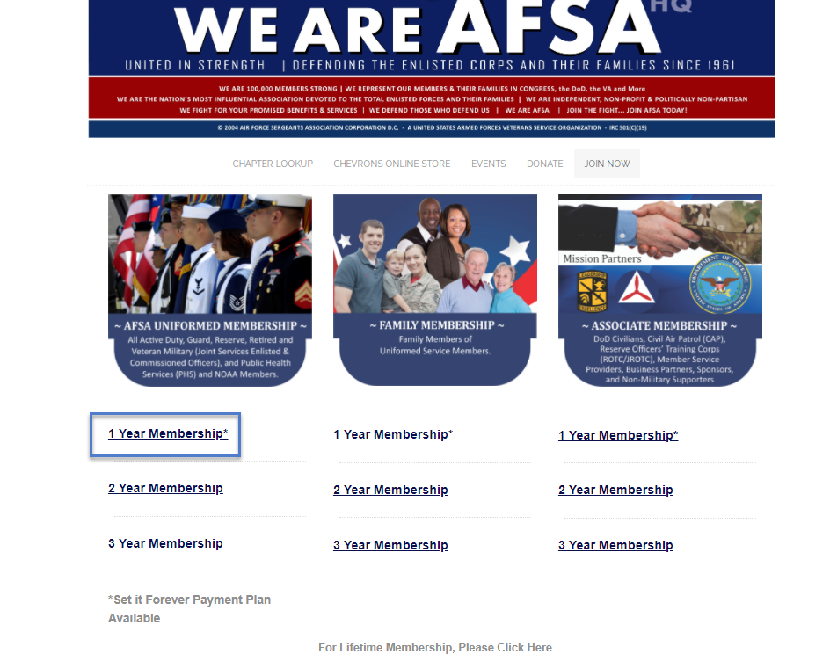
Click on the type of Type and Term of membership you are looking for.
In this example we are select the Uniformed membership for 1 year.

Slide 4
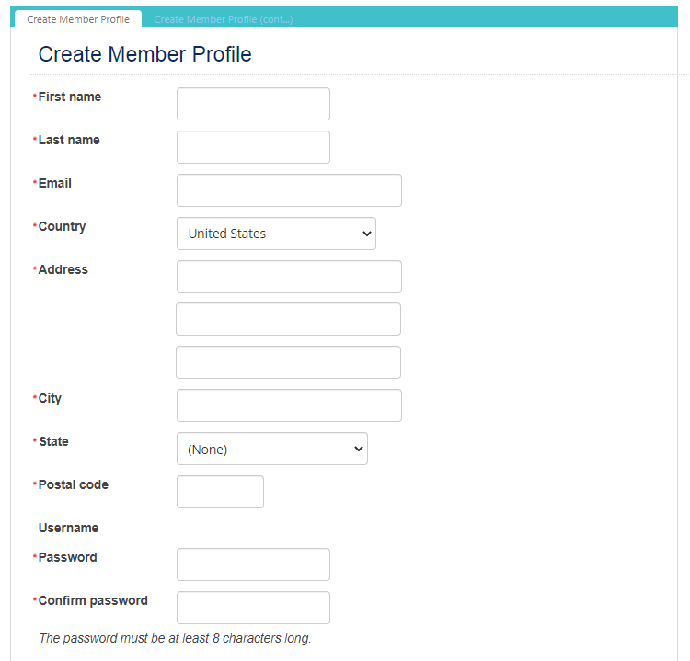
You are then taken to the Create Member Profile page to enter the new members information
The username will automatically be the email address of the person so please make sure it is valid.
Click on the Next button at the bottom of the page to continue

Slide 5
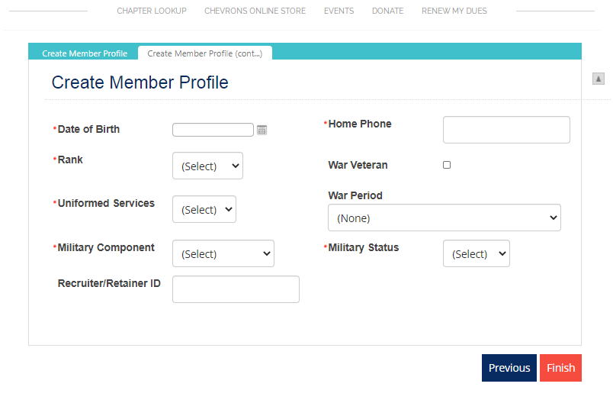
Be sure to enter all the required information.
There is also a field to enter the Recruiter/Retainer ID.
Click Finish to proceed with the join process

Slide 6
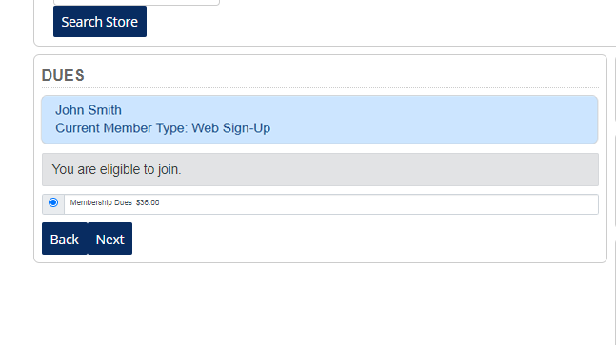
This is displaying the membership price that was selected from the previous screen
Click Next to Continue

Slide 7
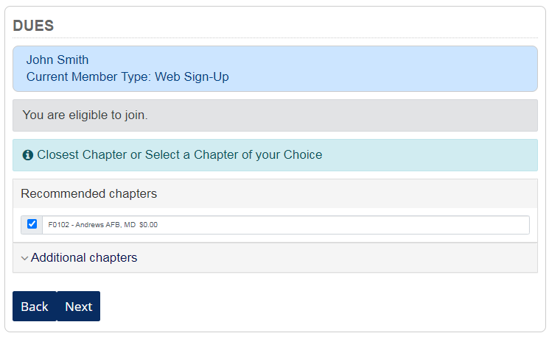
On this screen, the system shows you the closest Chapter to the zip code you entered. You will need to either select the Chapter the system provides, or you can click on Additional Chapters to select a different one.
Click Next to continue

Slide 8
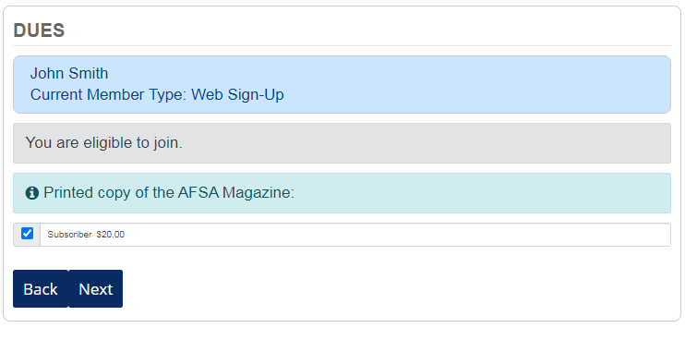
You are given the opportunity to sign up for a printed copy of the AFSA Magazine. You can select this option or bypass it and click Next to continue.

Slide 9
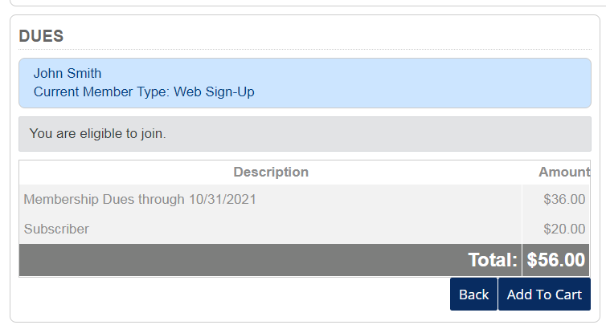
This is a review of the items that were selected so far. You would need to click the Add to Cart to continue.

Slide 10
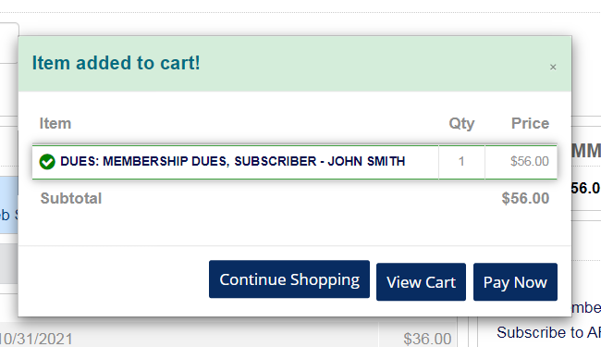
After clicking Add to Cart, you will see this popup message. You can either Continue Shopping and get taken to the Chevron’s store or you can pay now.
In this example, we are selected the Pay Now button.

Slide 11
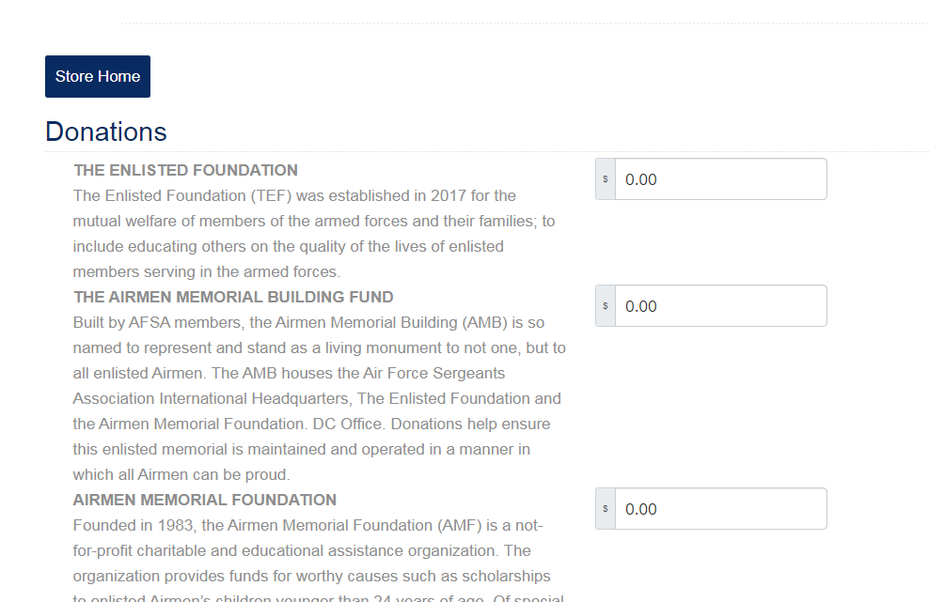
This next screen allows you to also add a donation to your transaction. This is not required, and you can click Pay Now button to continue to the payment screen

Slide 12
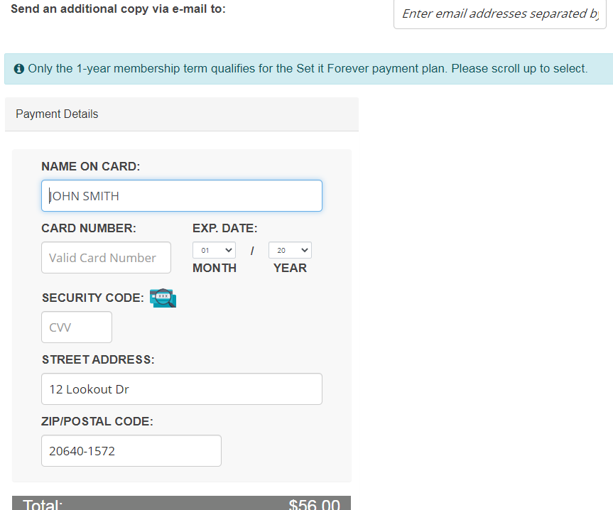
On the pay now screen, the site show the payment details first. The message on the page is to direct those folks that signed up for a 1-year membership to scroll up to take advantage of the Set it Forever payment plan.

Slide 13
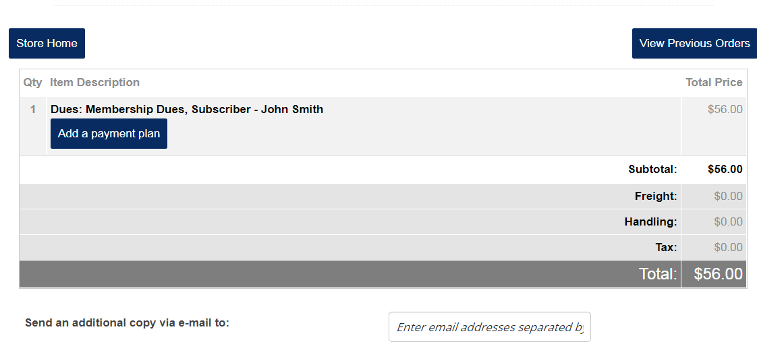
Click the Add a payment plan button to begin the sign-up process for Set it Forever

Slide 14
You must click the Accept button to proceed.
The statement reads:
“I authorize the AFSA HQ to auto renew my annual dues from the credit card number as listed at the prevailing membership dues rate at the time of renewal.”

Slide 15
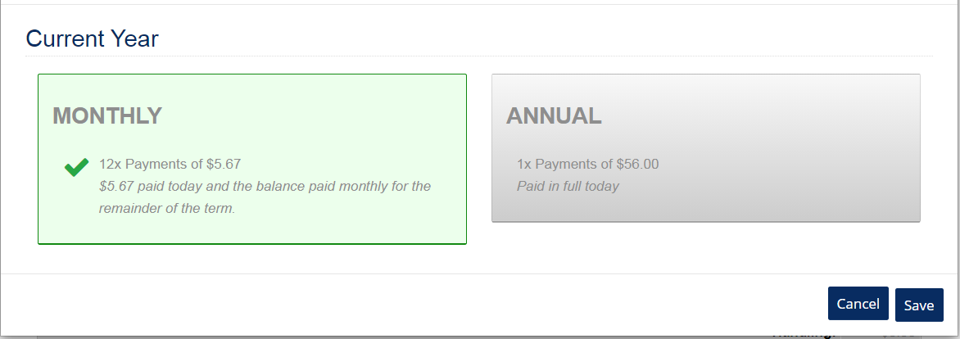
They have two options here:
Sign-up for a monthly payment or select the Annual payment.
In this example, we selected the Monthly option

Slide 16
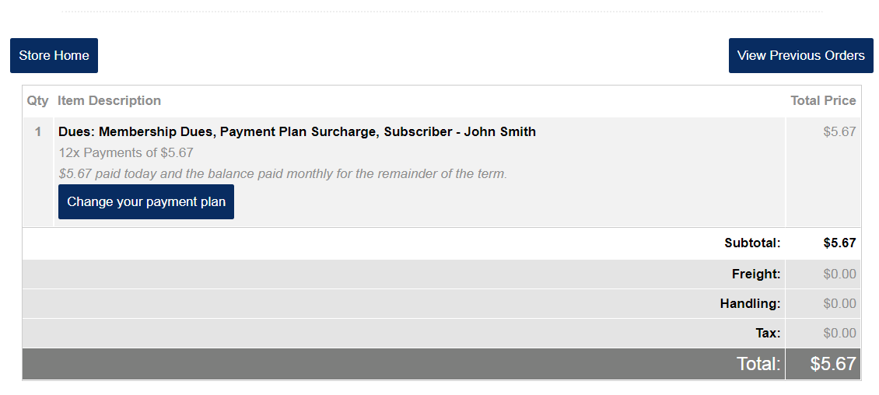
You are then taken back to the cart screen to process your payment. You are able to also go back and change your payment plan if you decide to pay in full instead of the monthly option. From here you would scroll down…

Slide 17
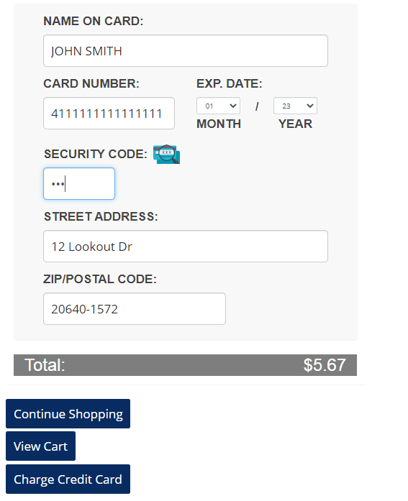
And enter your payment information to process payment. Once all information is entered you will click the Charge Credit Card button to process the transaction.

Slide 18
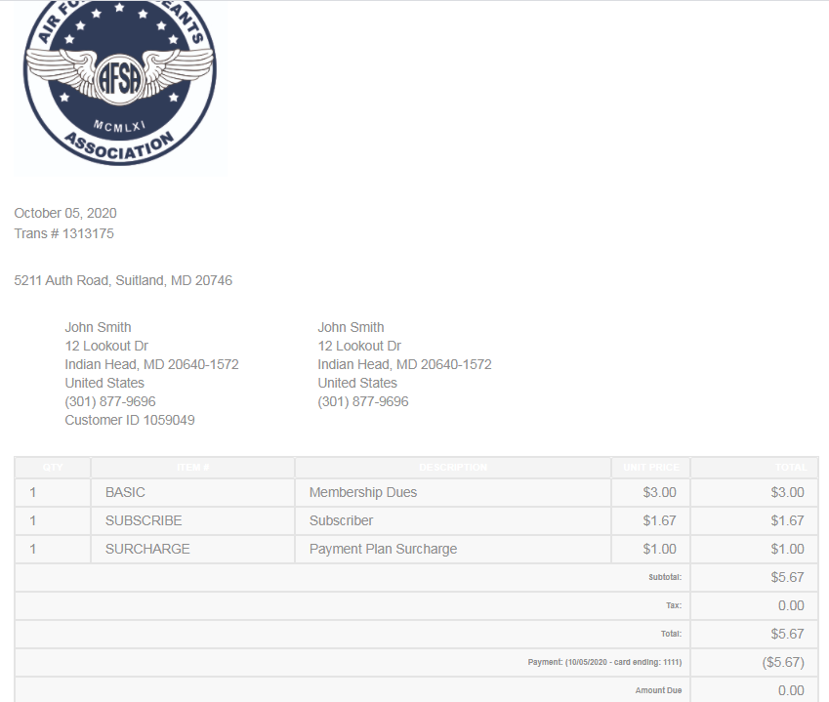
This is the receipt you will see after the payment as been processed. To exit this screen click on the Store Home button and you will be taken to the Chevron's store.

